Slide 1




Notes:
*

Slide 2


UI ENGINEERING STUDIO
UI Engineering Studio. Day 3 Bootcamp: CSS - Layout

Slide 3


UI ENGINEERING STUDIO
Cascading Style Sheets - Layout
CSS page layout techniques allow us to take elements contained in a web page and control where they are positioned relative to their default position in normal layout flow, the other elements around them, their parent container, or the main viewport/window.
- Mozilla Web Docs
Box Model
Display, float & position
Format
Homework

Slide 4
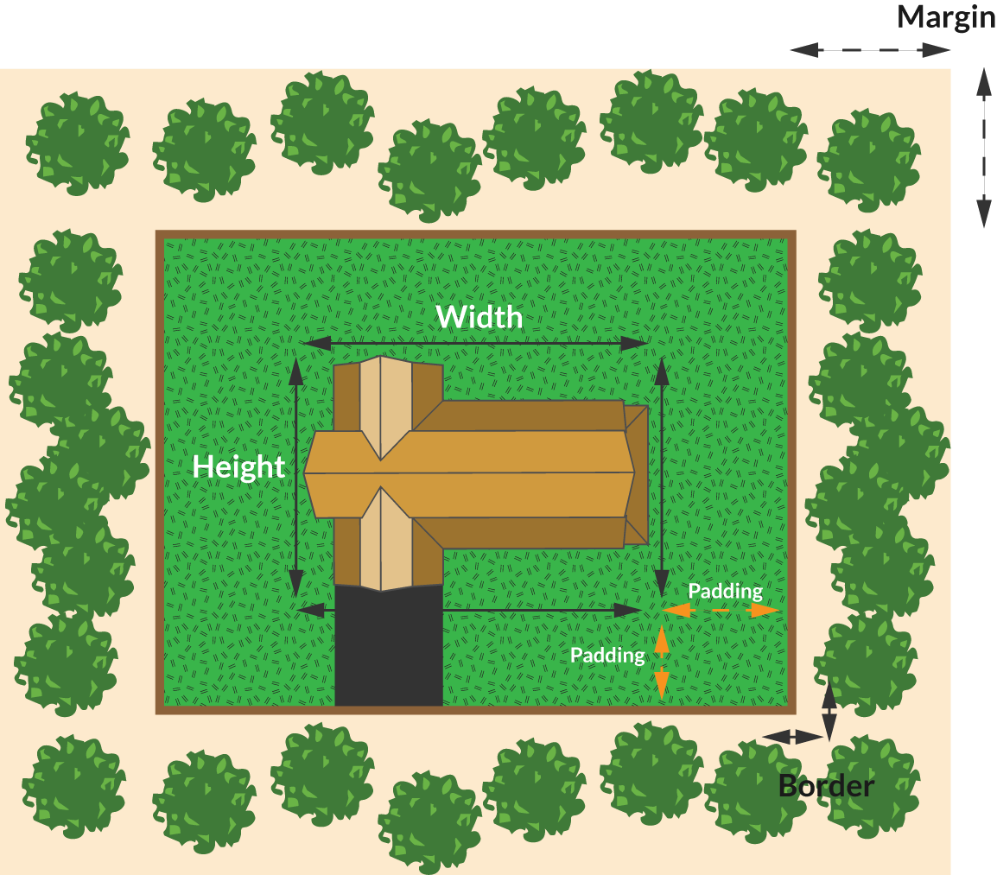
UI ENGINEERING STUDIO
UI Boot Camp: CSS - Layout Box Model
Notes:
Source: https://medium.freecodecamp.org/css-box-model-explained-by-living-in-a-boring-suburban-neighborhood-9a9e692773c1

Slide 5
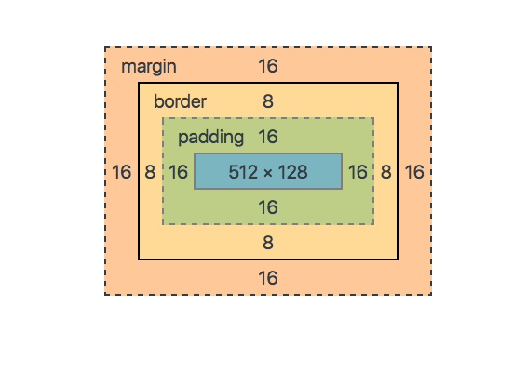
UI ENGINEERING STUDIO
UI Boot Camp: CSS - Layout Box Model
If I have an element with width of 512px and a height of 128px, what will it be its total width?
Content width + padding-left + padding-right + border-left + border-right + margin-left + margin-right
512 + 16 + 16 + 8 + 8 + 16 +16 = 592

Slide 6
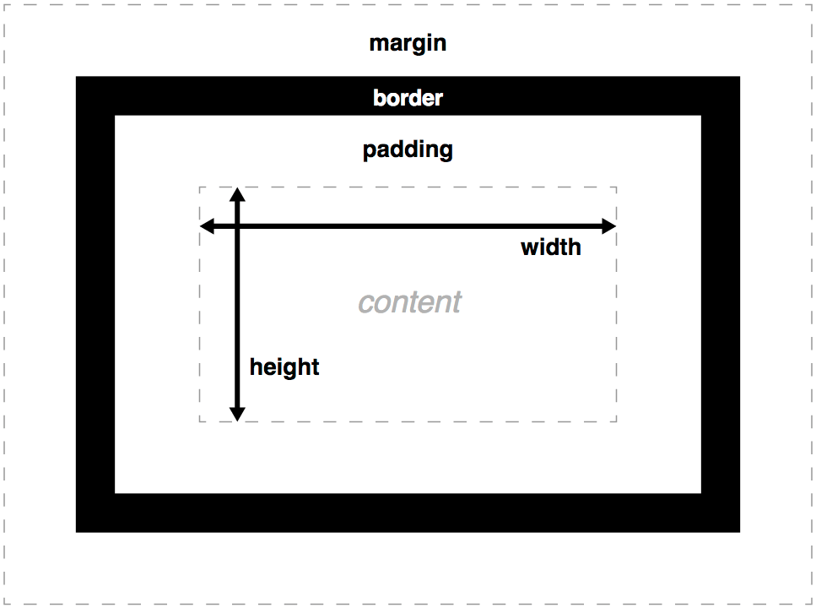
UI ENGINEERING STUDIO
UI Boot Camp: CSS - Layout
box-sizing:
content-box (default)
padding-box
border-box
Source: mozilla

Slide 7
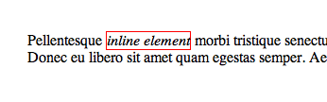
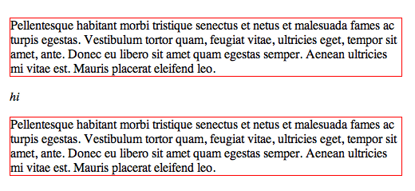
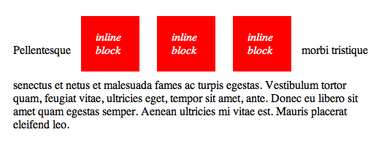
UI ENGINEERING STUDIO
UI Boot Camp: CSS - Layout Display, float & position
inline
display:
block
inline-block
Source: css-tricks.com

Slide 8

UI ENGINEERING STUDIO
UI Boot Camp: CSS - Layout Display, float & position
float:
left
right
none (default)
clear:
left
right
both
none (default)
Source: css-tricks.com

Slide 9
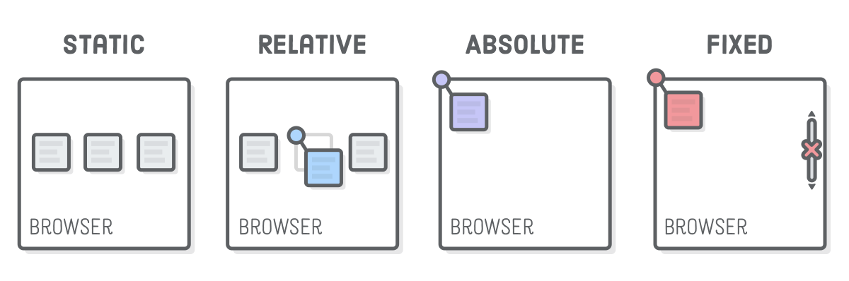
UI ENGINEERING STUDIO
UI Boot Camp: CSS - Layout Display, float & position
position:
static
relative
absolute
fixed
Source: https://internetingishard.com/html-and-css/advanced-positioning/

Slide 10
UI ENGINEERING STUDIO
UI Boot Camp: CSS - Layout Format
background | background-image background-position background-size background-repeat background-attachment background-origin background-clip background-color

Slide 11
UI ENGINEERING STUDIO
UI Boot Camp: CSS - Layout Format
font | font-family line-height font-weight font-stretch font-variant font-size

Slide 12
UI ENGINEERING STUDIO
UI Boot Camp: CSS - Layout Format
text | color direction letter-spacing text-align text-decoration text-indent text-shadow text-transform text-overflow vertical-align white-space word-spacing

Slide 13

UI ENGINEERING STUDIO
UI Boot Camp: CSS Homework: Magazine Cover

Slide 14
Notes:
*

